Slide 1
Blacktown Chinese Christian Church
Welcome to Our English Service
06.09.2026
English Service 9:45 – 11:00 am
Worship Songs:
Passage:
Speaker:
Topic:
Response Song:
Announcements and Closing Prayer
Benediction
Lighthouse At the Cross Jerusalem Start a Fire
2 Corinthians 9
Katharine Ting
Laughing All the Way to Heaven

Slide 2
BCCC english service

Slide 3
Jerusalem
CCLI Licence No: 5485849

Slide 4
See Him in Jerusalem
Walking where the crowds are
Once these streets had sung to Him
Now they cry for murder

Slide 5
Such a frail and lonely man
Holding up the heavy cross
See Him walking in Jerusalem
On the road to save us

Slide 6
See him there upon the hill
Hear the scorn and laughter
Silent as a lamb he waits
Praying to the father

Slide 7
See the king who made the sun
And the moon and shining stars
Let the soldiers hold and nail him down
So that he could save them

Slide 8
See him there upon the cross
Now no longer breathing
Dust that formed the watching crowds
Takes the blood of Jesus

Slide 9
Feel the earth is shaking now
See the veil is split in two
And he stood before the wrath of God
Shielding sinners with his blood

Slide 10
See the empty tomb today
Death could not contain him
Once the servant of the world
Now in victory reigning

Slide 11
Lift your voices to the one
Who is seated on the throne
See him in the new Jerusalem
Praise the one who saved us (x2)

Slide 12
Praise the one who saved us

Slide 13
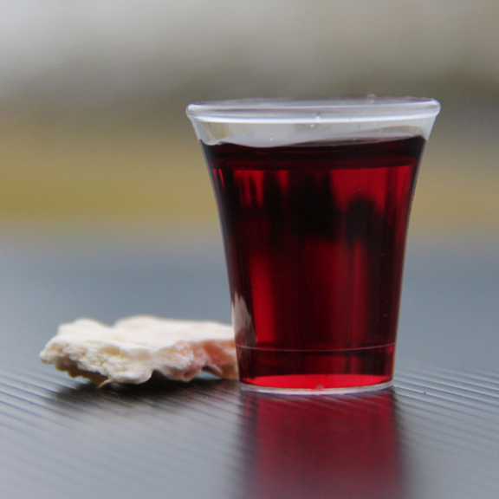
Holy Communion

Slide 14

Bible reading

Slide 15
2 Corinthians 9
There is no need for me to write to you about this service to the Lord’s people. ² For I know your eagerness to help, and I have been boasting about it to the Macedonians, telling them that since last year you in Achaia were ready to give; and your enthusiasm has stirred most of them to action.

Slide 16
2 Corinthians 9
³ But I am sending the brothers in order that our boasting about you in this matter should not prove hollow, but that you may be ready, as I said you would be. ⁴ For if any Macedonians come with me and find you unprepared, we—not to say anything about you—would be ashamed of having been so confident.

Slide 17
2 Corinthians 9
⁵ So I thought it necessary to urge the brothers to visit you in advance and finish the arrangements for the generous gift you had promised. Then it will be ready as a generous gift, not as one grudgingly given.
⁶ Remember this: Whoever sows sparingly will also reap sparingly, and whoever sows generously will also reap generously.

Slide 18
2 Corinthians 9
⁷ Each of you should give what you have decided in your heart to give, not reluctantly or under compulsion, for God loves a cheerful giver. ⁸ And God is able to bless you abundantly, so that in all things at all times, having all that you need, you will abound in every good work.

Slide 19
2 Corinthians 9
⁹ As it is written:
“They have freely scattered their gifts to the poor;
their righteousness endures forever.”
¹⁰ Now he who supplies seed to the sower and bread for food will also supply and increase your store of seed and will enlarge the harvest of your righteousness.

Slide 20
2 Corinthians 9
¹¹ You will be enriched in every way so that you can be generous on every occasion, and through us your generosity will result in thanksgiving to God.
¹² This service that you perform is not only supplying the needs of the Lord’s people but is also overflowing in many expressions of thanks to God.

Slide 21
2 Corinthians 9
¹³ Because of the service by which you have proved yourselves, others will praise God for the obedience that accompanies your confession of the gospel of Christ, and for your generosity in sharing with them and with everyone else. ¹⁴ And in their prayers for you their hearts will go out to you, because of the surpassing grace God has given you.

Slide 22
2 Corinthians 9
¹⁵ Thanks be to God for his indescribable gift!

Slide 23
Announcements

Slide 24





Account name: Blacktown Chinese Christian Church
Account number: 4216 50263
Offering
BSB: 112 - 879
Please put in "offering" as the reference
The offering box is available at the back of the hall

Slide 25
Prayer points

Slide 26
Mingle time!

